Slide 1
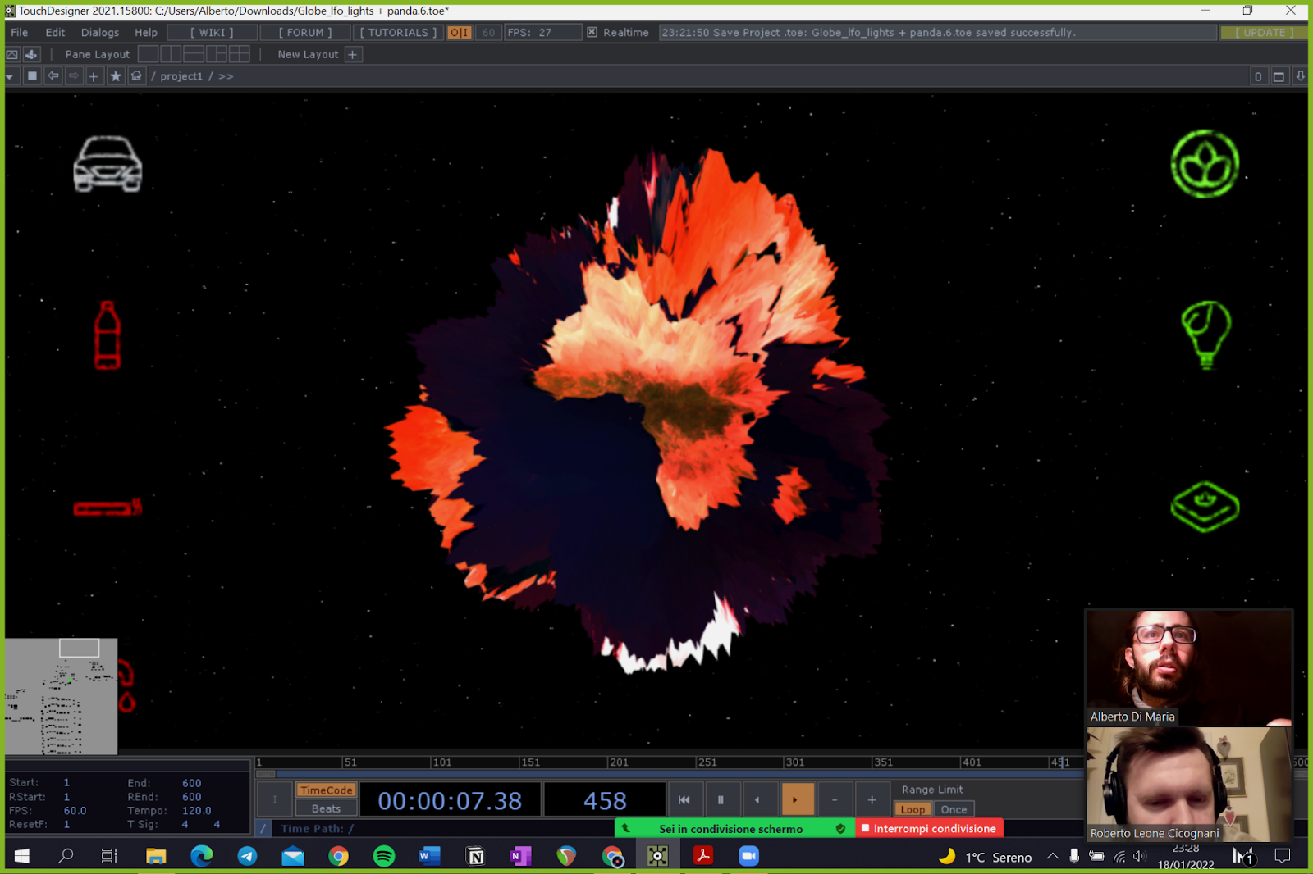
Save the World!
Your gestures matter
Roberto Alessandri - Roberto Leone Cicognani
Alberto Di Maria - Enrico Regondi
Notes:
LEONE
Introduce the general topic
Challenges you will be exploring
Presentation purpose (WHY)
Statement of the aim of the presentation
Move to the section division (next slide)

Slide 2
Gaylord Nelson,
founder of Earth Day
“The ultimate test of man’s conscience may be his willingness to sacrifice something today for future generations whose words of thanks will not be heard”
Notes:
CONTEXT AND MOTIVATION
-User thinks about the impact of daily life action (sensibilization)
-Positive and negative (cenni)
-Effects of the actions(all people on earth) - detto così non ha senso
- We looked for some data (you can find it in the end)

Slide 3

Structure
01
02
03
How it works
GUI Overview
Demo
04
05
06
Interaction
Communication
Summary

Slide 4
How it works
Mercury
Mars
Saturn
Gestures caption
Gestures recognition
Visual feedback
01
02
03
Notes:
SUPER importante

Slide 5



Software
Touch Designer
Python
SuperCollider
(GUI)
(Gesture Recognition)
(Background Sound)

Slide 6

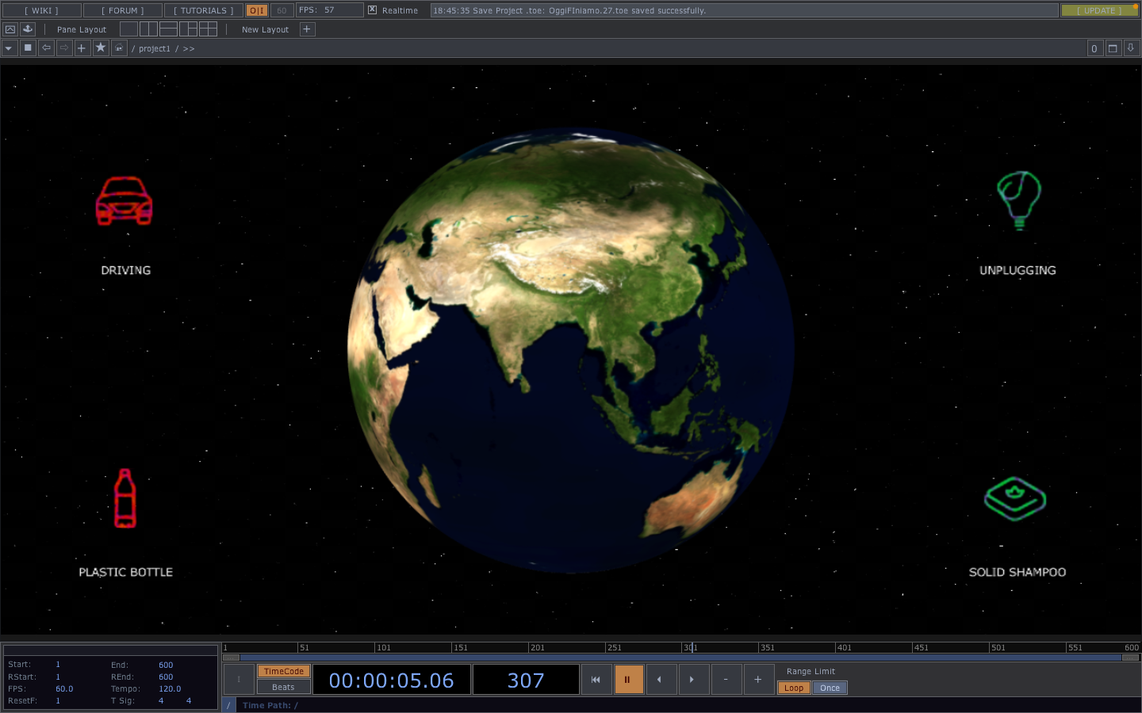
GUI
Notes:
ARTA
Consists of …
User reactive
Planet + icons → available gestures for the user
Each animation

Slide 7
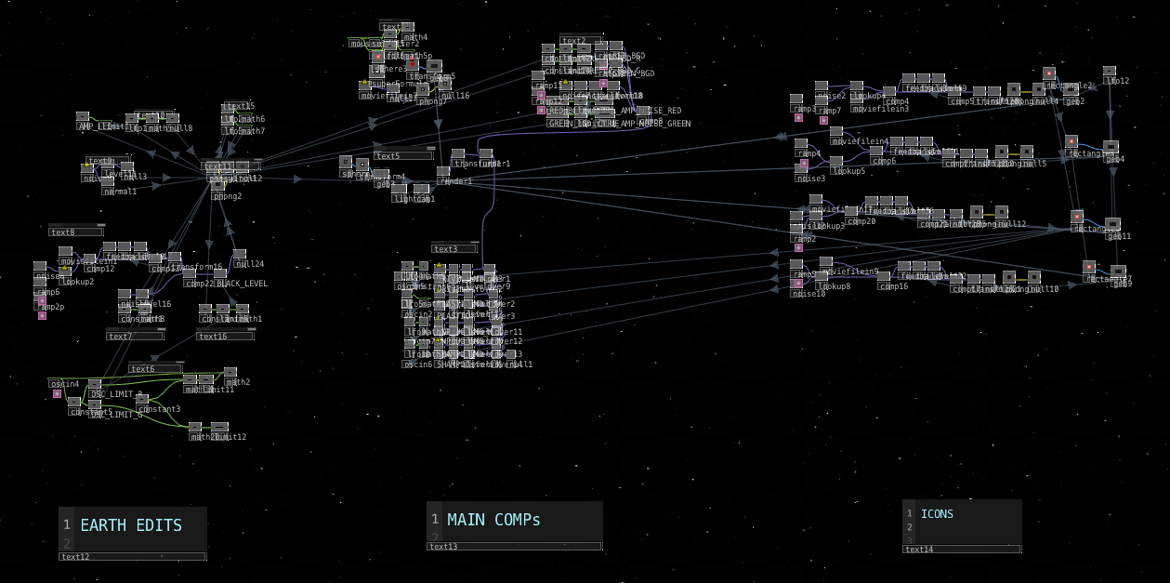
TD scheme
Notes:
Earth edits: osc net + phong colore e oscillazione (made with lfos)
Main comps: geometric comp of Earth + text part + background
Icons: icons and their characteristics
Emphasize the connections

Slide 8
Let’s see a
real - time demo!

Slide 9

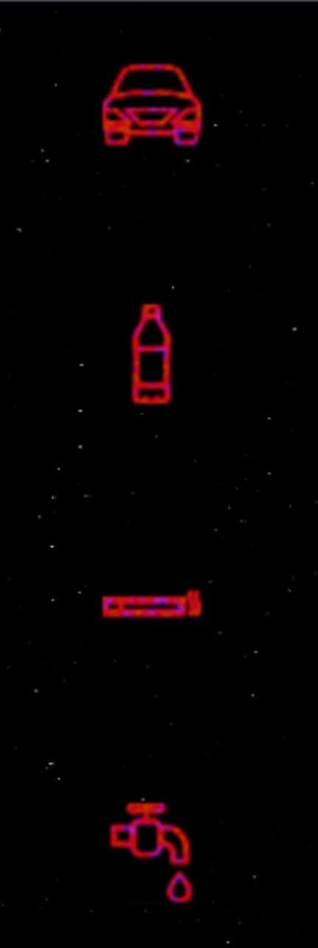
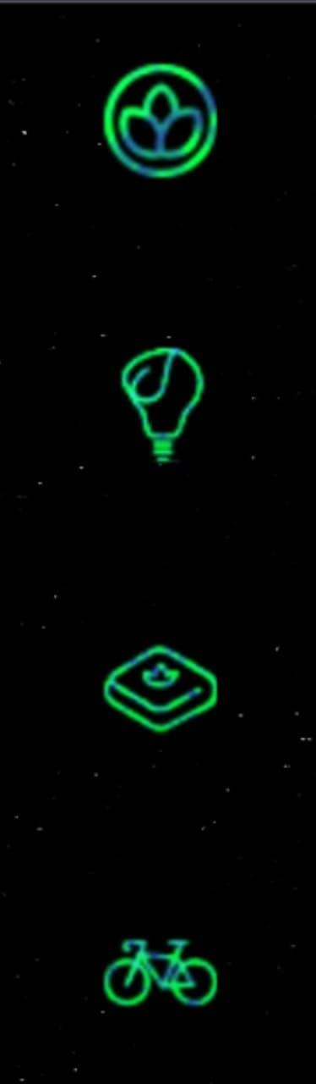
Interaction
User’s gestures
Webcam
Role of the icons
Notes:
RIEN

Slide 10

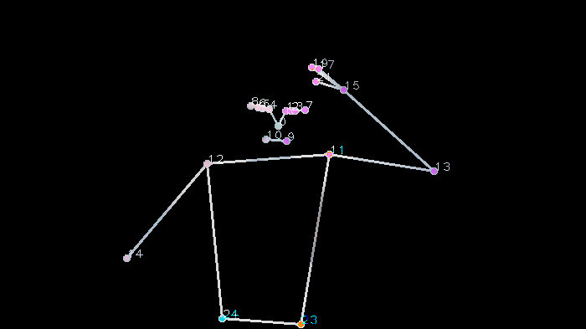
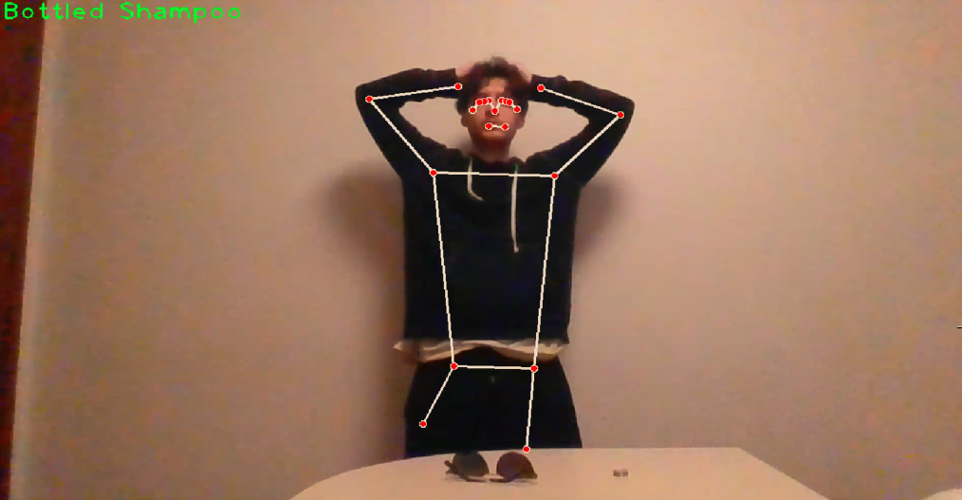
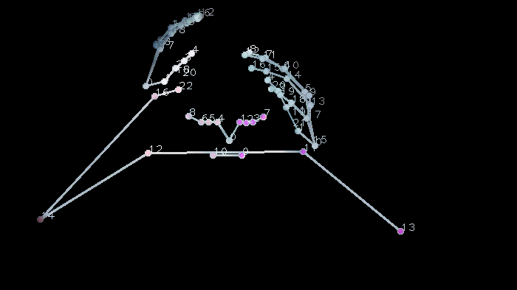
Gesture Recognition

Slide 11
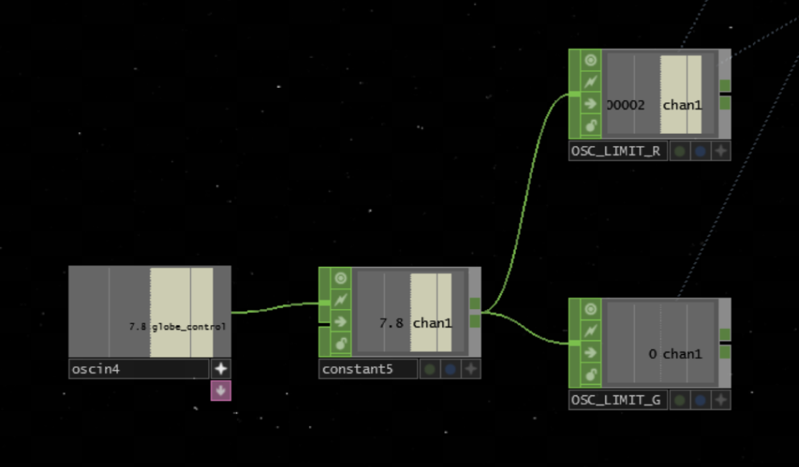
Communication
Weighted parameters calculation
Information sent to GUI (via OSC)
Live reaction of the GUI
Notes:
BOB
Based on the pose it will calculate a parameter that will have a negative value if the user is doing a “bad action” or positive value if is doing a “good action”. Once the parameter is calculated, it will send the information thru OSC messages to the GUI that will change accordingly.

Slide 12
Supercollider
3 Sinusoidal Oscillators
Strong processing with Audio FXs
Smooth ADSR
Notes:
BOB
Based on the pose it will calculate a parameter that will have a negative value if the user is doing a “bad action” or positive value if is doing a “good action”. Once the parameter is calculated, it will send the information thru OSC messages to the GUI that will change accordingly.

Slide 13
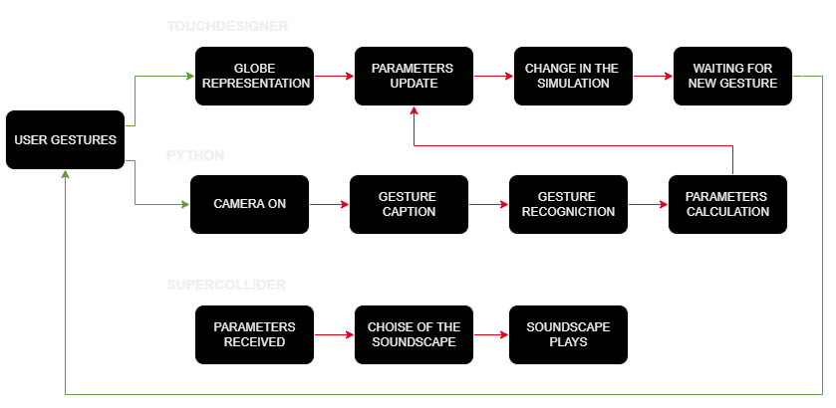
Summary
Notes:
Here next, you can see a scheme that explains briefly how our system will work. So, as said before, everything will be handled by the back-end, that will be responsible to extract information, calculate parameters and send information to touch designer, that will change the simulation.

Slide 14
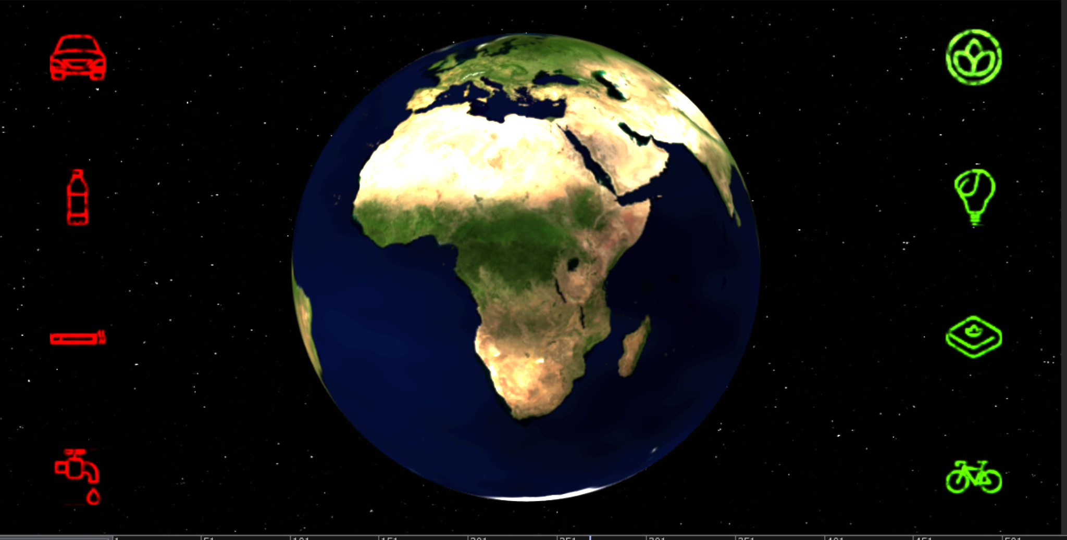
Thanks!
Your gestures matter. A lot.
Will you be able to
Save the World?
Notes:
La foto si può cambiare

